Slide 1

Mini Project Review -1 SUICIDE RATE PREDICTION AND ANALYSIS USING MACHINE LEARNING
Project Members:
Project Investigator:
Dr. M. MAYURANATHAN
Assistant Professor-Sel.G
SUBASH M (142221104134)
VIGNESHWAR S (142221104156)
VISHWA M (142221104161)

Slide 2
ABSTRACT
This project focuses on analyzing suicide rates using machine learning techniques.
Data preprocessing steps such as cleaning, normalization, and feature engineering are performed to prepare the dataset for analysis.
Machine learning algorithms, including regression and classification models, are implemented to predict death rates.
Visualization techniques are employed to present the findings and interpret the results effectively.
This project serves as a valuable educational tool for exploring the intersection of machine learning and public health.

Slide 3
.
AIM
.
The aim of the project "Suicide Rate Prediction with Machine Learning" is to predict suicide rates using machine learning algorithms.
Gather diverse data on suicide rates, demographics, and socio-economic factors.
Analyze data to understand patterns and correlations influencing suicide rates.
Develop predictive models using machine learning algorithms.
Evaluate model performance and interpret results for insights.
Deploy user-friendly interface for stakeholders to access predictions.
Ensure ethical considerations are addressed throughout the project.

Slide 4
DOMAIN DESCRIPTION
MACHINE LEARNING:
Machine learning is a subfield of artificial intelligence (AI) that focuses on the development of algorithms and models.
It enable computers to learn from data and make predictions or decisions without being explicitly programmed.
The core idea behind machine learning is to allow computers to learn from experience, identify patterns, and improve their performance over time.
PROBLEM:
Data Quality Issues: Poor quality or incomplete data can significantly impact the accuracy and reliability of the analysis.
Missing values, inconsistencies, and errors in the data may need to be addressed through data preprocessing techniques such as imputation, normalization, and outlier detection.
Data Bias: The dataset may suffer from bias, leading to skewed results and inaccurate predictions.
Bias can arise from various sources, including sampling bias, measurement bias, and societal biases.

Slide 5
ALGORITHMS USED:
Random Forest: Random Forest is an ensemble learning algorithm that combines multiple decision trees to improve predictive performance.
It's particularly useful for handling complex datasets with nonlinear relationships between features and outcomes.
Gradient Boosting Machines (GBM): GBM is another ensemble learning technique that builds a sequence of decision trees, with each tree learning to correct the errors of its predecessors.
GBM algorithms such as XGBoost and LightGBM are known for their high predictive accuracy and scalability, making them suitable for suicide rate prediction tasks.
Logistic Regression: Logistic regression is a popular algorithm for binary classification tasks, where the goal is to predict whether an individual will commit suicide or not based on input features.
It's a simple yet effective algorithm that provides interpretable results.

Slide 6
OBJECTIVE
Suicide is a serious public health problem.
The World Health Organization (WHO) estimates that every year close to 800 000 people take their own life, which is one person every 40 seconds and there are many more people who attempt suicide.
Suicide occurs throughout the lifespan and was the second leading cause of death among 15-29-year-olds globally in 2016.
Suicide does not just occur in high-income countries but is a global phenomenon in all regions of the world.
In fact, over 79% of global suicides occurred in low- and middle-income countries in 2016. On average, in US there are 129 suicides per day.
The objective of this project is to predict the suicide rates using Machine Learning algorithms and analyzing them to find correlated factors causing increase in suicide rates globally.

Slide 7
LITERATURE SURVEY
1. Mohd. Asif Ansari, Shubh NarainTiwari, Shivang Gupta,“Suicide Rate Prediction Using Machine Learning”, International Journal of Advances in Engineering and Management (IJAEM), Volume 4 (ISSN: 2395-5252, pp: 2731-2737,year:2022,DOI: 10.35629/5252-040527312737).
Description:
The paper aims to predict suicide rates using machine learning techniques.It likely explores various factors or variables that may contribute to predicting suicide rates, such as socio-economic factors, mental health statistics, and other relevant data points.
PROS:
Data-Driven Insights
Predictive Capabilities
CONS:
Ethical Considerations
Algorithm Bias

Slide 8
LITERATURE SURVEY(continued)
2. Priyank singh Hada,Horesh Kumar,” Machine Learning Techniques for Prediction of Mental Health” 2021 3rd International Conference on Inventive Research in Computing Applications (ICIRCA) (ISBN:978-1-6654-3877-3, Publisher: IEEE,
DOI: 10.1109/ICIRCA51532.2021.9545061)
Description:
The paper may present findings on the effectiveness of different machine learning approaches in predicting mental health conditions. It could discuss the potential impact of these predictive models on early detection, intervention, and treatment strategies for mental health disorders. The authors might propose recommendations for further research or real-world applications based on their study's results and insights.
PROS:
Interdisciplinary Expertise
Practical Implementation Guidance
CONS:
Limited Discussion on Intervention Strategies
Complexity of Methods

Slide 9
LITERATURE SURVEY(continued)
3. Priyadarshini R, Beryl Abey Thomas,”Suicide: An Analysis and Prediction Using Pyspark and Machine Learning Models”(2023 International Conference on Research Methodologies in Knowledge Management , Artificial Intelligence and Telecommunication Engineering(RMKMATE).
(ISBN:979-8-3503-0570-8, Publisher: IEEE, DOI: 10.1109/RMKMATE59243.2023.10369484)
Description:
The paper may present insights into the factors contributing to suicide based on data analysis.It could discuss the effectiveness of Pyspark and machine learning models in predicting suicidal behavior. The authors might propose recommendations for preventive measures or interventions based on their analysis and predictive models.
PROS:
Interdisciplinary Expertise
Practical Implementation Guidance
CONS:
Limited Data Availability
Ethical Considerations Oversight

Slide 10
EXISTING SYSTEM
Statistical Models: Many existing systems rely on statistical models to analyze historical suicide data. These models often include time series analysis to identify trends and patterns over time.
Demographic Analysis: They incorporate demographic data such as age, gender, race, and socioeconomic status to understand the groups most at risk.
Geospatial Analysis: Some systems use geospatial analysis to identify geographic clusters of high suicide rates and target interventions accordingly.
Predictive Modeling: They develop predictive models that forecast future suicide rates based on historical trends and identified risk factors.
Visualization Tools: Many systems include visualization tools such as dashboards and interactive maps to communicate insights effectively to policymakers and healthcare professionals.

Slide 11
PROBLEMS IN EXISTING SYSTEM
Firstly, data quality issues, such as missing or inaccurate data entries, can undermine the reliability of predictive models.
Secondly, the choice of features may not encompass all relevant factors contributing to suicide rates, potentially leading to incomplete or biased predictions.
Moreover, model interpretability remains a crucial concern, as complex machine learning algorithms often lack transparency, hindering stakeholders' understanding and trust in the predictions.
By actively addressing these challenges and incorporating lessons learned from previous projects, future endeavors in suicide rate prediction and analysis can strive for greater accuracy, transparency, and societal impact.

Slide 12
PROPOSED SYSTEM
1. Data Collection and Preprocessing:
Gather diverse datasets containing demographic, socio-economic, mental health, and historical suicide rate data from reliable sources.
Clean and preprocess the data to handle missing values, outliers, and inconsistencies.
2. Exploratory Data Analysis (EDA):
Conduct exploratory data analysis to understand the distribution and relationships between different variables.
Identify correlations, trends, and patterns within the dataset.
3. Feature Engineering:
Extract relevant features from the dataset that are likely to influence suicide rates, such as socio-economic indicators, mental health statistics, and environmental factors.
Utilize techniques like dimensionality reduction and feature scaling to prepare the data for modeling.

Slide 13
4. Model Evaluation and Interpretation:
Evaluate the performance of developed models using appropriate evaluation metrics, such as accuracy, precision, recall, and F1-score.
Interpret the results to understand the significance of different features and their impact on predicting suicide rates.
5. Visualization and Presentation:
Develop visualizations such as line charts, bar graphs, heatmaps, and geographical maps to present insights effectively.
Provide interactive dashboards and tools for stakeholders to explore and interact with the data and model predictions.
By implementing these components, the proposed system aims to provide valuable insights into the complex issue of suicide rates and empower stakeholders to develop targeted interventions and prevention strategies effectively.

Slide 14
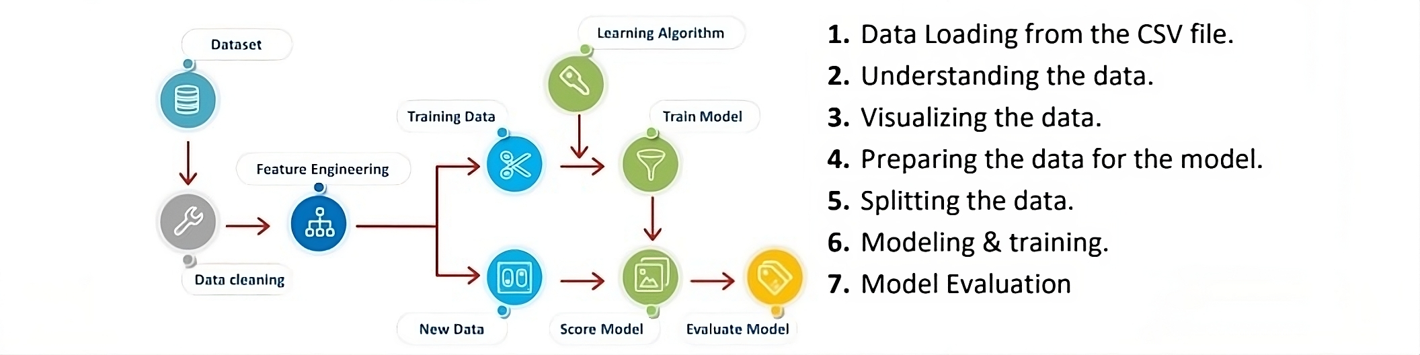
SYSTEM ARCHITECTURE

Slide 15
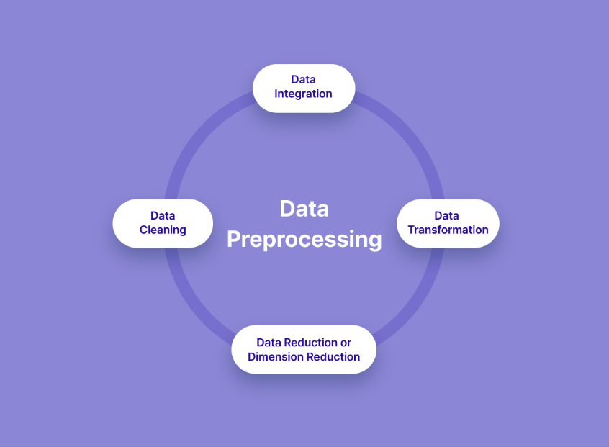
MODULE
MODULE 1:(Data Collection and Preprocessing Module)
Gathers data from multiple sources including government databases, research papers, and surveys.
Cleans the data by removing duplicates and irrelevant entries.
Handles missing values through imputation techniques.
Addresses outliers by detecting and either correcting or removing them.
Performs normalization to scale features to a standard range.
Encodes categorical variables into numerical format.

Slide 16
MODULE(Continued)
MODULE 2:(Feature Engineering Module)
Selects features based on their relevance to suicide rate prediction.
Creates new features by combining or transforming existing ones.
Conducts feature scaling to ensure all features have equal importance.
Removes irrelevant or redundant features through feature selection techniques.
Applies domain-specific knowledge to engineer features that capture socio-economic, demographic, and mental health-related factors.

Slide 17
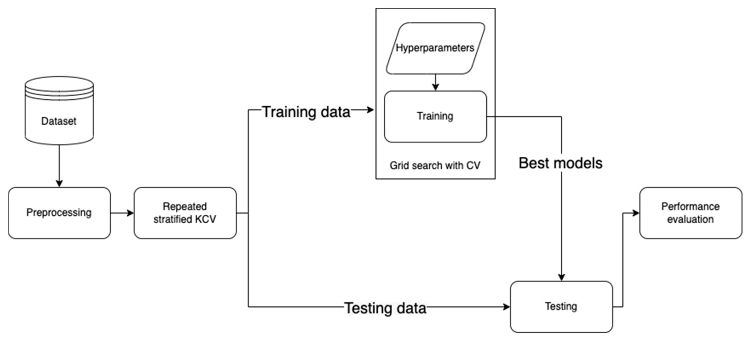
MODULE(Continued)
MODULE 3:(Machine Learning Model Development Module)
Implements various machine learning algorithms such as regression and Gradient Boosting.
Trains models on the preprocessed dataset.
Evaluates model performance using metrics like accuracy, precision, recall, and F1-score.
Optimizes model hyperparameters through techniques like grid search or random search.
Conducts cross-validation to ensure the models generalize well to unseen data.

Slide 18
MODULE(Continued)
MODULE 4:(Model Evaluation and Interpretation Module)
Visualizes model performance using plots such as ROC curves or precision-recall curves.
Identifies the most important features contributing to model predictions using techniques like permutation importance.
Provides explanations for individual predictions through methods like LIME (Local Interpretable Model-agnostic Explanations).
Presents insights and findings in a clear and understandable manner to stakeholders.

Slide 19
MODULE(Continued)
MODULE 5:(Deployment and Integration Module)
Integrates the trained models into a production environment or software application.
Provides APIs or interfaces for easy integration with other systems or platforms.
Monitors model performance in real-time and updates models as needed.
Ensures compliance with privacy regulations and ethical considerations in model deployment.
Collaborates with relevant stakeholders for effective utilization of the predictive models.

Slide 20
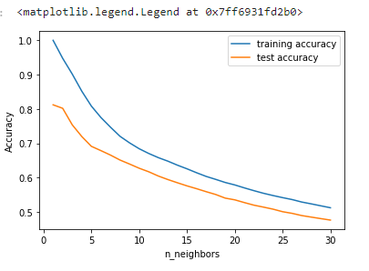
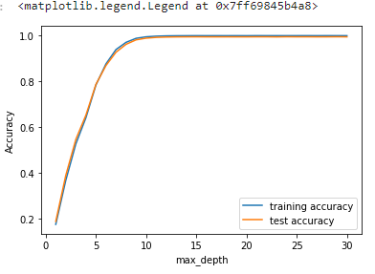
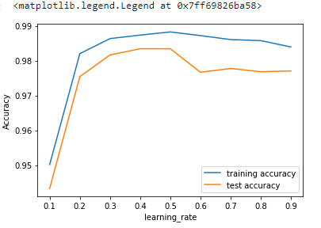
OUTPUT
K-nearest neighbor
Random forest
Gradient boosting

Slide 21
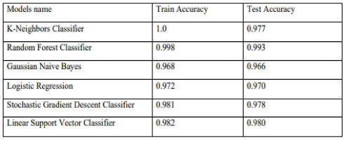
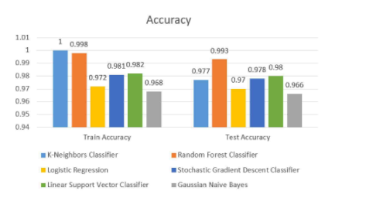
RESULT

Slide 22
REFERNCES
1. Mohd. Asif Ansari, Shubh NarainTiwari, Shivang Gupta,“Suicide Rate Prediction Using Machine Learning”, International Journal of Advances in Engineering and Management (IJAEM), Volume 4 (ISSN: 2395-5252, pp: 2731-2737,year:2022,DOI: 10.35629/5252-040527312737).
2. Priyank singh Hada,Horesh Kumar,” Machine Learning Techniques for Prediction of Mental Health” 2021 3rd International Conference on Inventive Research in Computing Applications (ICIRCA) (ISBN:978-1-6654-3877-3, Publisher: IEEE, DOI: 10.1109/ICIRCA51532.2021.9545061).
3. Priyadarshini R, Beryl Abey Thomas,”Suicide: An Analysis and Prediction Using Pyspark and Machine Learning Models”(2023 International Conference on Research Methodologies in Knowledge Management , Artificial Intelligence and Telecommunication Engineering(RMKMATE). (ISBN:979-8-3503-0570-8, Publisher: IEEE, DOI: 10.1109/RMKMATE59243.2023.10369484)

Slide 23
THANK YOU

